Slide 1

Blake Association
AllyIn

Slide 2
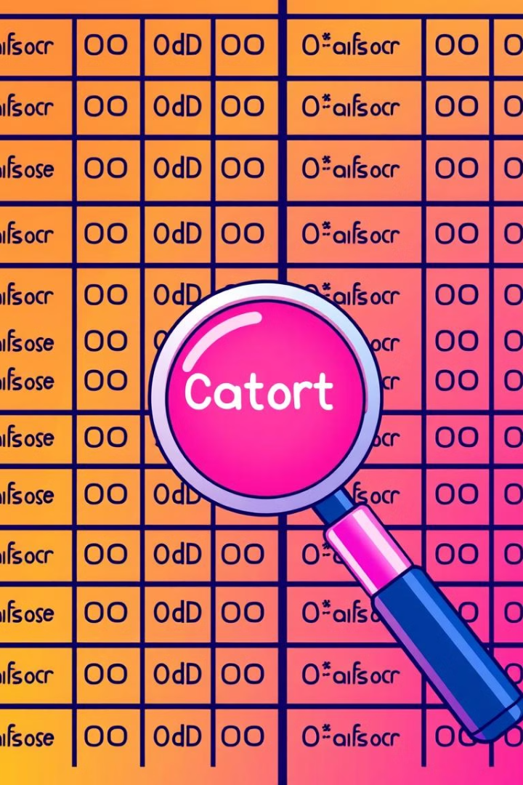
Automated Classifier Selection
Our code primarily focuses on receiving a query about data, identifying the relevant dataset, and generating an intelligent response. It uses OpenAI's GPT model for natural language processing to understand queries and provide insights based on data.

Slide 3
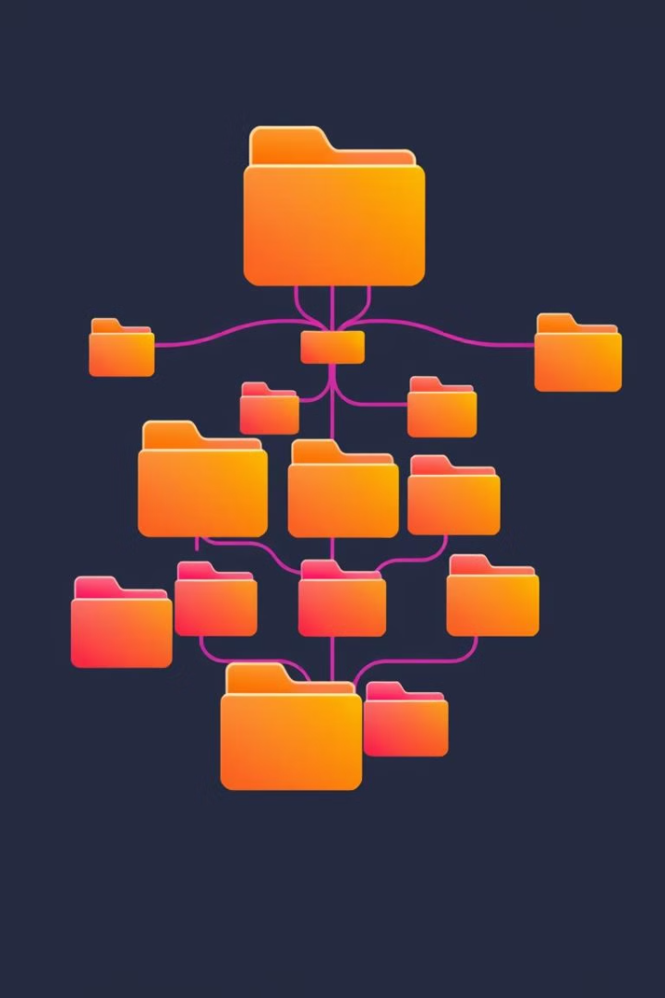
Tree structure
1
Automated selection of classifications
2
Creating folders tree
3
Recursive tree building

Slide 4

Dividing the dataset into smaller ones
Define the division criterion
Partitioning
The dataset is divided based on the specified criterion from the user's request
Specifies the criterion for dividing the dataset.
Saving parts
Processing or analyzing each part
Each part is stored as a separate object in a list or other data structure.
The individual parts of the dataset are passed on for further processing or analysis.

Slide 5

OnClick
1
One click
2
Define the main thing
3
Saving the new datasets
4
Response to the user

Slide 6
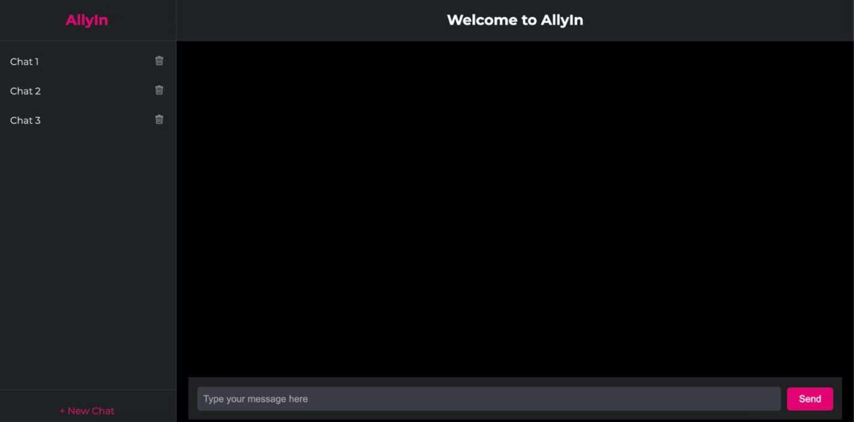
Our Chat
This is how our chat looks like in the usual format. We tried to make the chat convenient and modern to use.

Slide 7
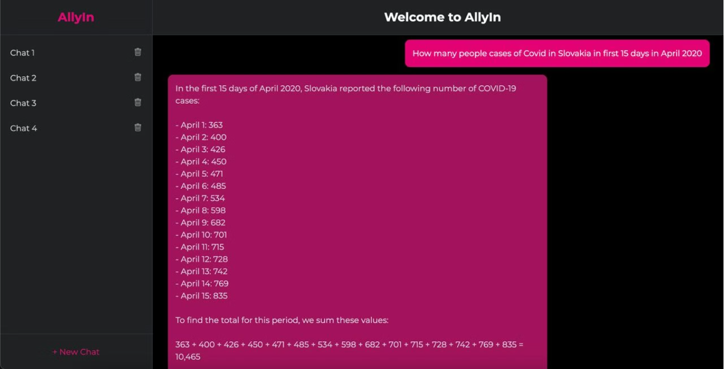
Chat requests
Data from one country

Slide 8
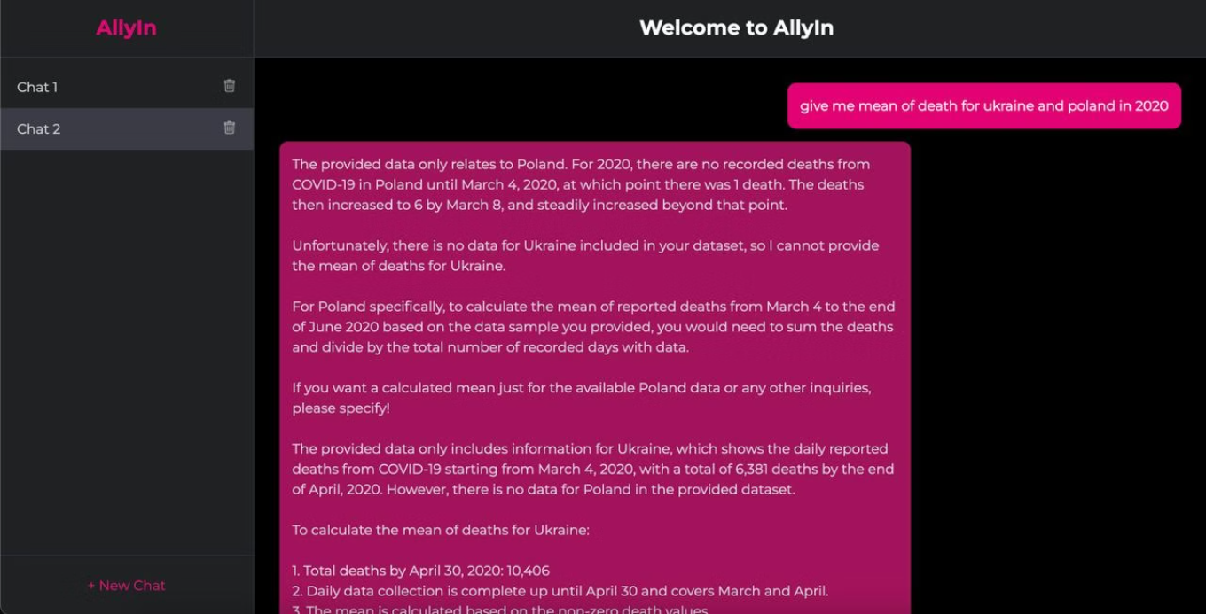
Chat requests
Data from two countries

Slide 9
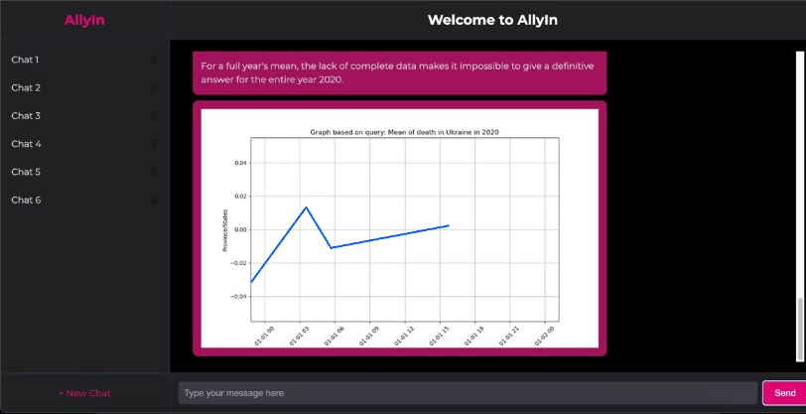
Visualization of data
Based on the text received as an answer, a graph is generated to visualize the answer

Slide 10

Work smart not hard

